Slide 1
SQL Server R Services – An Introduction
Dave Thulborn

Slide 2
Microsoft R Product Family Includes:
Microsoft R Open
Microsoft R Client
Microsoft R Server
SQL Server R (In-Database)
SQL Server Machine Learning Services (R and Python)
Notes:
Microsoft R Open
Microsoft R Open is the enhanced distribution of R from Microsoft Corporation. It is a complete open source platform for statistical analysis and data science. Being based on the open source R engine makes Microsoft R Open fully compatibility with all R packages, scripts and applications that work with that version of R. Microsoft R Open delivers performance boosts, in comparison to the standard R distribution, since R Open leverages high-performance, multi-threaded math libraries. This is Microsoft’s enhanced version of the R language.
Microsoft R Client
Microsoft R Client is a free, community-supported, data science tool for high performance analytics. R Client is built on top of Microsoft R Open so you can use any open source R package to build your analytics. Additionally, R Client introduces the powerful ScaleR technology and its proprietary functions to benefit from parallelization and remote computing. A lot of data scientists also use Rstudio (https://www.rstudio.com/products/RStudio/#Desktop), but now the Microsoft R Client is also available (http://aka.ms/rclient/). Finally, there is a Visual Studio template set for writing ‘R’ (https://Microsoft.github.io/RTVS-docs/installation.html)
Microsoft R Server
You can use Microsoft R Server for distributed computing on multiple platforms. When you install from SQL Server setup, you get the Windows-based server and all the required tools for publishing and deploying models. Microsoft R Server is most likely to be used when the data being analysed sits in non SQL Server environment (e.g. HADOOP / TarraData / etc..).
SQL Server Machine Learning Services
SQL Server provides a platform for developing intelligent applications that uncover new insights. You can use the rich and powerful R language and the many open source packages to create models and generate predictions using your SQL Server data.
In SQL Server 2016, Microsoft introduced SQL Server R Services, a feature that supports enterprise-scale data science by integrating the R language with SQL Server database engine.
In SQL Server 2017, machine learning becomes even more powerful, with addition of support for the popular Python language. To reflect the support for multiple languages, as of CTP 2.0, SQL Server R Services has also been renamed as Machine Learning Services (In-Database).

Slide 3
What will we cover – Machine Learning Services
What gets installed?
The SQL Server Extensibility Architecture
R and SQL Server Together
R with SQL Server is Scalable and Secure
Resource Pools, Best Practices, Monitoring, and Troubleshooting
SQL Server and R at Scale

Slide 4
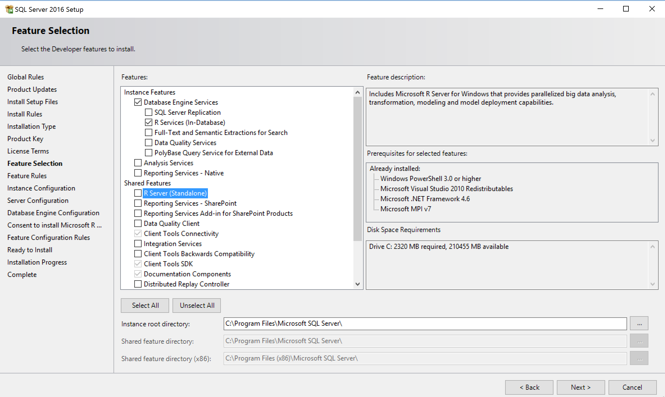
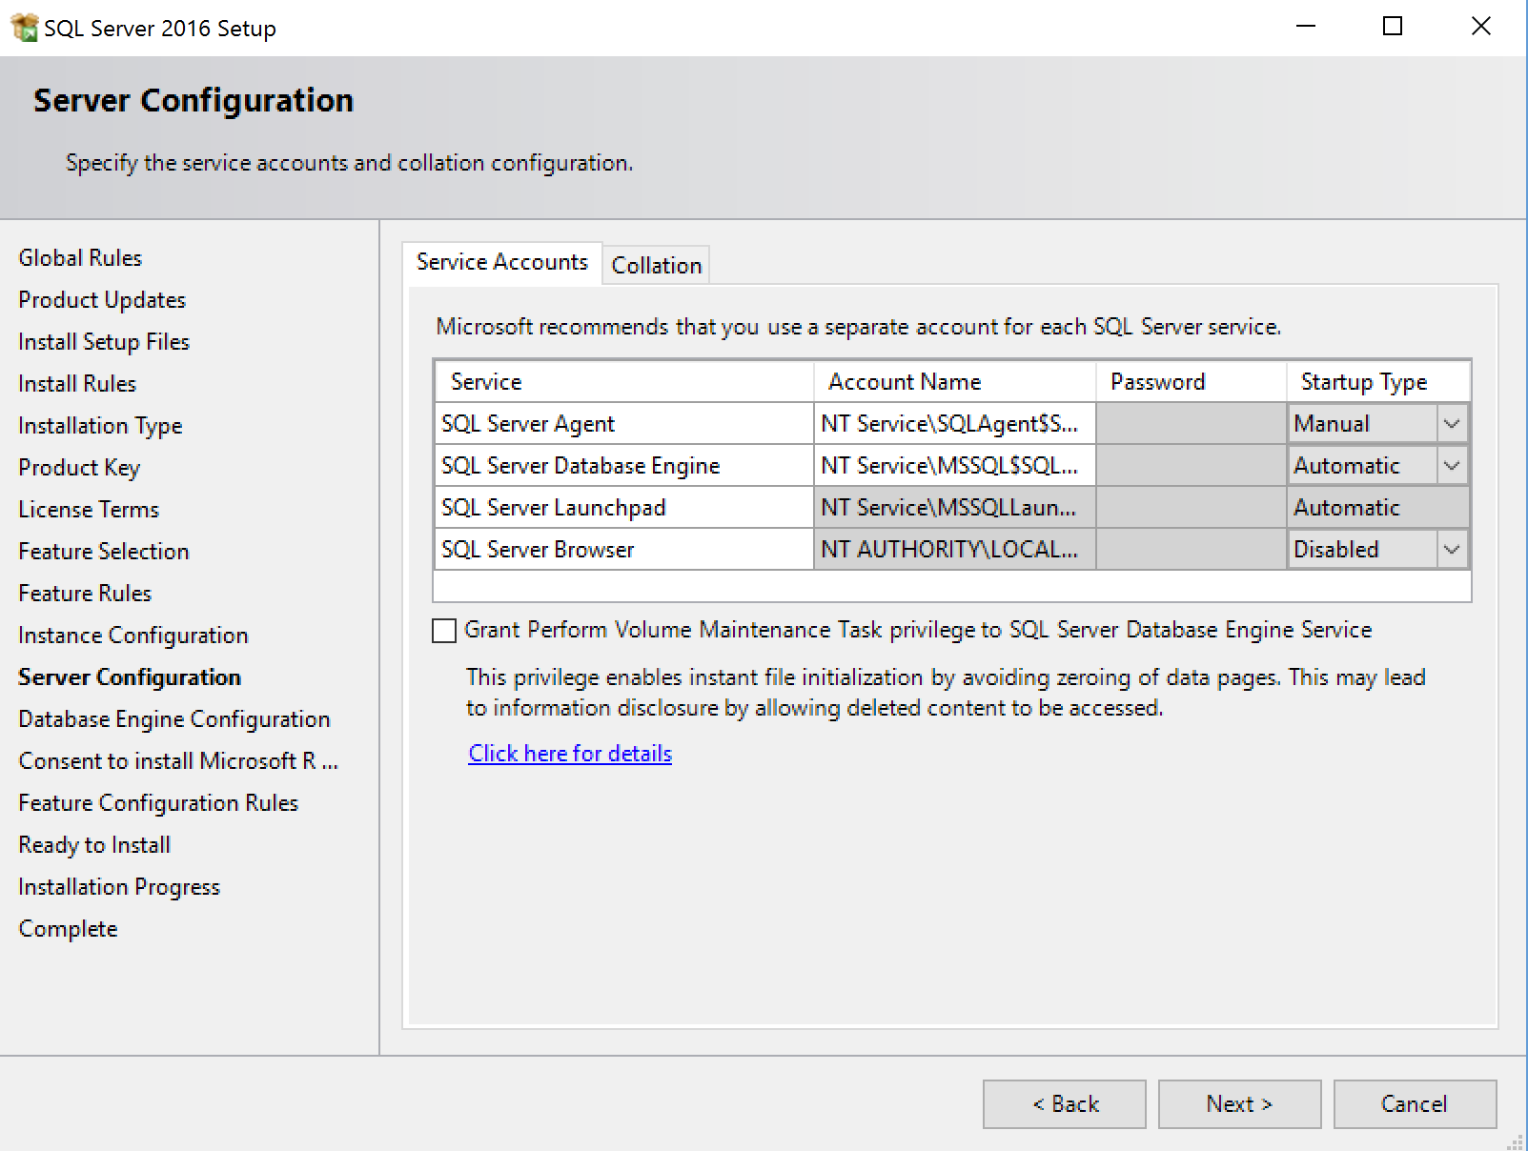
What Gets Installed?
Not installed by default in Azure VM
Some differences by edition
SQL Server R Services
Microsoft R Server
Notes:
MPI is Messaging Passing Interface and is used by R and ScaleR to support parallel computing: https://msdn.microsoft.com/en-us/library/bb524831(v=vs.85).aspx

Slide 5
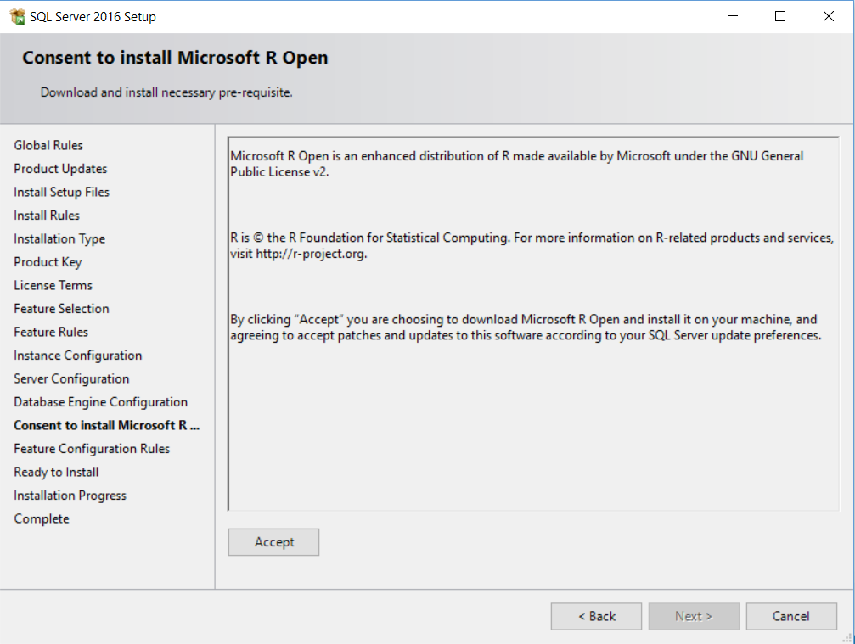
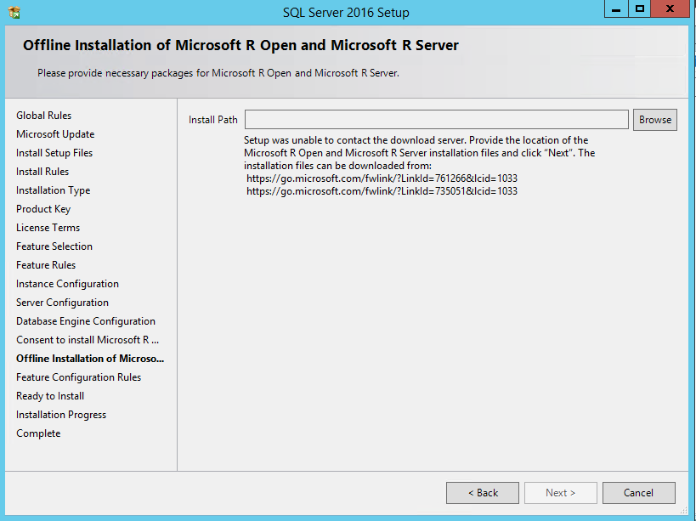
What Gets Installed?
The offline experience
You must download both
Open Source R Package
Microsoft R Package
A few things to do for Azure VM
CUs and SPs will have new download packages
Don’t forget /IACCEPTROPENLICENSETERMS for unattended installs
Rsetup.exe and rsetup.log
Notes:
This is one of the very few scenarios where setup has to connect to the internet

Slide 6
Demo: Configuration
Notes:
Follow the instructions in justshowus\readme.txt

Slide 7

The SQL Extensibility Architecture
Each SQL instance has a launchpad
MSSQLSERVER Service
MSSQLLAUNCHPAD Service
Windows “satellite” process
Windows “satellite” process
launchpad.exe
Windows “satellite” process
sqlservr.exe
Windows “satellite” process
Named pipe
sp_execute_external_script
“launcher”
“What” and “How”
to “launch”
SQLOS
XEvent
Windows “satellite” process
sqlsatellite.dll
Notes:
Talk about other “extensible” environments we have used in the past
xproc
sp_OA
Linked servers
Full-text

Slide 8
sp_execute_external_script
Getting started with R docs installed in R_SERVICES\doc
R is only currently supported script language today – SQL 2017 introduces Python
execute sp_execute_external_script
@language = N'R'
, @script = N'
x <- as.matrix(InputDataSet);
y <- array(dim1:dim2);
OutputDataSet <- as.data.frame(x %*% y);'
, @input_data_1 = N' SELECT [Col1] from MyData;'
, @params = N'@dim1 int, @dim2 int'
, @dim1 = 12, @dim2 = 15
WITH RESULT SETS (([Col1] int, [Col2] int, [Col3] int, [Col4] int));
R script. Use a @var or read from a file
Input data for script. Can be any T-SQL SELECT.
Parameters for script. OUTPUT supported
Messages can also be returned including STDOUT and STDERR
Result set binding
Notes:
sp_execute_external_script is an example of a special proc or specproc. The source code of the procedure can’t be found in the resource db. It is implemented in our source code

Slide 9
R Integration with SQL Server
docs
Windows Job Object
process pool
This is all local!
Local User Account
MSSQLSERVER Service
MSSQLLAUNCHPAD Service
rterm.exe
Service SID
Service SID
Open R
sqlservr.exe
launchpad.exe
conhost.exe
rlauncher.dll
rxlink.dll
sp_execute_external_script
pipe
CreateProcess
pipe
rlauncher.dll
CreateProcess
Local User Account
rlauncher.dll
compile input data query
Send message to pipe
Execute input query
Push results
Pull results
BxlServer.exe
R script
SQLOS
XEvent
ScaleR
“satellite” process
interleaved
SNI/TCP – Comm technology as SQL
Retrieve input rows and params
Send back results and output params
stdout and stderr
sqlsatellite.dll
SATELLITE_* wait type
Notes:
We deploy a “process pool” when launching scripts so when you run a script execution you will see more than one rterm/bxlserver pair. Since rterm is a windows console app you will also see a conhost.exe for each rterm.exe
Rterm = R runtime command interpreter
Bxlserver = Microsoft R Server process which also hosts sqlsatellite.dll

Slide 10
R Services (In-Database) is scalable
Enterprise Edition gives you the optimum scalability
More efficient than standalone R clients
Data does not have to all fit in memory
Reduced data transmission over the network
Most R Open functions are single threaded
Use the ScaleR APIs for scalable R scripts that are multi-threaded on the SQL Server computer
We can stream data in parallel and batches from SQL Server
Use the power of SQL Server and R Server to develop, train, and execution
SQL Server Compute Context
T-SQL queries
Columnstore indexes
Data compression
Parallel query execution
Stored procedures
It’s all about using the compute power of the server close to the data
Notes:
Perhaps the #1 reason why SQL R Services is a value proposition is because we are pushing the computing power of SQL Server queries and R scripts to the server leaving the R client to analyze the results (such as plots)

Slide 11
R Services (In-Database) is secure
Reduced surface area and isolation
‘external scripts enabled’ required
R script execution outside of SQL Server process space
Script execution requires explicit permission
sp_execute_external_script requires EXECUTE ANY EXTERNAL SCRIPT for non-admins
SQL Server login/user required and db/table access
Satellite processes has limited privileges
Satellite processes run under local user accounts in the SQLRUserGroup
Each execution is isolated. Different users with different accounts
Windows firewall rules to block outbound traffic
MSSQLSERVR0n

Slide 12
Best Practices and Performance Considerations
docs recommend min 32Gb
Computer with enough cores, memory, and disk speed
High Performance Power Option
Balance memory needed by SQL Server and external pool
Launchpad needs specific privileges
Be sure SQLRUserGroup has log on local rights
Restart the SQL Server Service not stop/start (Launchpad is dependent)
8dot3 notation needs to be enabled. Read more here
Remote ODBC execution requires SQLRUserGroup login
20 unique users allowed to execute R scripts concurrently by default
SQL Server Query and Index design still apply
R scripts can often benefit from tuning
Default max memory is 20% of RAM
Need to add more?

Slide 13
SQL Server External Resource Pools
Windows Job Objects
internal, default, “user”, and now external
Controls resources for external processes through Launchpad.
Default external pool and user external pools. User classifier function supported
The controls
MAX_CPU_PERCENT – Max CPU percentage for external processes
MAX_PROCESSES – Max number of external processes
MAX_MEMORY – Max committed memory % for external processes
AFFINITY – Control NODEs or CPUs for external processes
Each pool requires a separate job object
dynamic
Min is 12 due to process pool. conhost.exe doesn’t count. 0 = unlimited

Slide 14
Managing, Monitoring, and, Troubleshooting
DMVs
dm_external_script_execution_stats – monitor ScaleR API executions
dm_external_script_requests – active script execution
Perfmon counters: SQL Server:External Scripts
Extensibility LOGs and R Services LOGs in LOG\ExtensibilityLog directory
XEvents
Events for SQL Server, Launchpad, and external processes
Configuration file needed for Launchpad and external processes
procexp and procmon from sysinternals
SQL Server 2016 CU1 has some important fixes
R profiler for performance tuning of R scripts

Slide 15
Demo: Monitoring
Notes:
Follow the instructions in justshowus\readme.txt

Slide 16
SQL Server and R @ Scale
Fraud detection at 1 million predictions per second
SQL Server R 100 times faster at price optimizations for airline tickets and hotel rooms price predictions

Slide 17
Resources
Start here with the docs
SQL team blog post
Experiences from the SQLCAT team
bobsql blog series
Tiger team blog series
Revolution Analytics blog series

Slide 18
R Services - Achievement Unlocked

Slide 19
Bonus Material

Slide 20
What is installed for R?
<sql install dir>\Microsoft SQL Server\MSSQL13.<instance>\R_SERVICES
R libraries
library
R documentation
doc
R tools
bin
Microsoft ScaleR libraries
library\RevoScaleR
How to install other R packages
SQL specific binaries are installed in MSSQL\BINN

Slide 21
R Integration with SQL Server – SQL Server Compute Context
sqlCompute <- RxInSqlServer(connectionString = sqlConnString, wait = TRUE, consoleOutput = TRUE)
rxSetComputeContext("sqlCompute")
R Client
rterm.exe
Open R
sqlservr.exe
rterm.exe
rxlink.dll
RODBC
launchpad.exe
sp_execute_external-script
CreateProcess
pipe
BxlServer.exe
BxlServer.exe
sqlsatellite.dll

